Slide 1

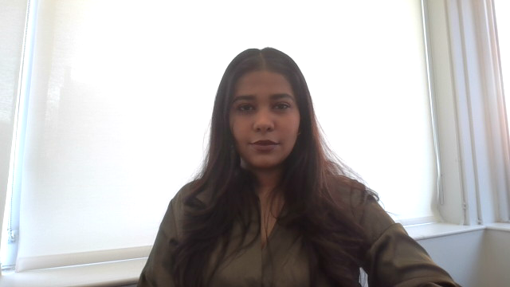
Name: Miss. Bhavika Paresh Bhavsar Date: 11/28/2023
Enhancing Health Care through Computer Vision and Clinical Natural Language Technology

Slide 2

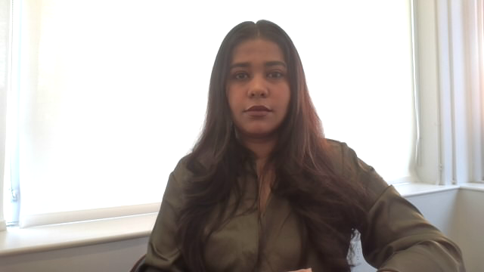
Introduction
In this digital age, health care is significantly influenced by technological advancements. Among these, Computer Vision (CV) and Clinical Natural Language Processing (NLP) stand out for their ability to interpret clinical records and enhance healthcare outcomes

Slide 3
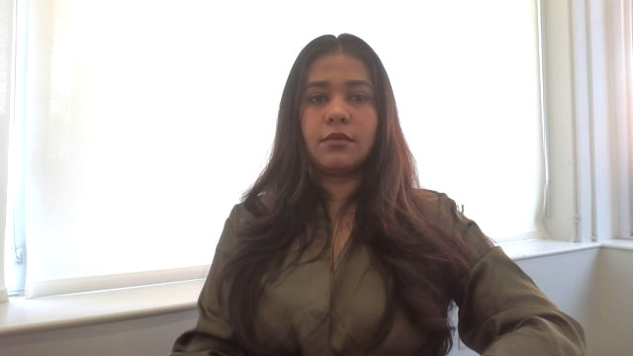
Historic Context
The journey of CV and NLP in healthcare is characterized by significant evolution. From basic tasks like edge detection to understanding complete medical scenes, CV has made remarkable progress. Simultaneously, NLP has become instrumental in providing accurate diagnoses and personalized treatments

Slide 4

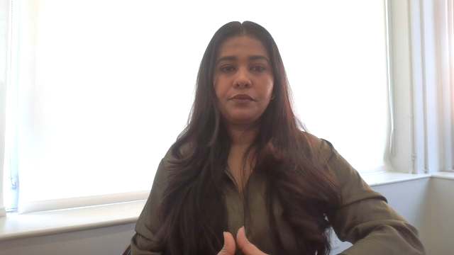
Current Trends
CV is now pivotal in diagnostic radiology, aiding in detecting anomalies in medical imaging. Meanwhile, NLP extracts crucial information from unstructured healthcare data, such as electronic health records. These technologies often match or surpass the accuracy of expert physicians, reducing diagnostic errors.

Slide 5

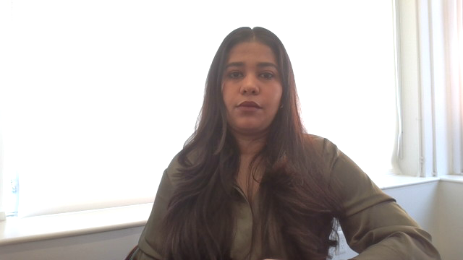
Future Outlook
Advancements in AI and machine learning are set to further enhance CV and NLP capabilities, leading to more integrated and accurate systems. This progress promises automated diagnostic systems and more efficient patient data management

Slide 6

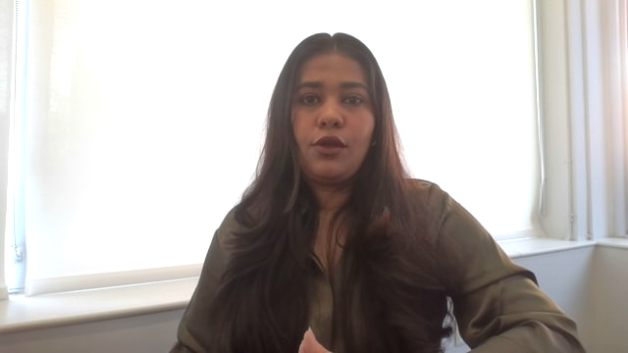
Opportunities for Cotiviti
For Cotiviti, embracing CV and NLP technologies offers significant opportunities. These include developing integrated solutions for comprehensive healthcare analytics, improving diagnostic tools, and optimizing data management.

Slide 7

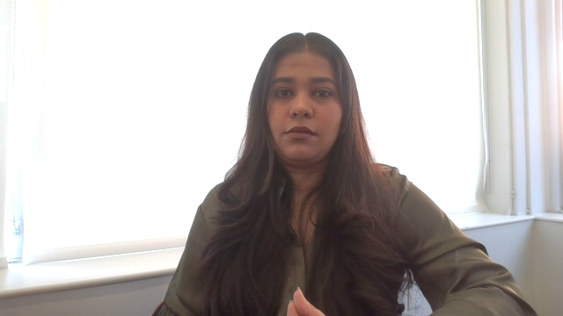
Conclusion
The integration of CV and clinical NLP in healthcare is a necessary step towards the future of medical care. For organizations like Cotiviti, strategic investment in these technologies could yield substantial advancements in healthcare technology and patient care service

Slide 8
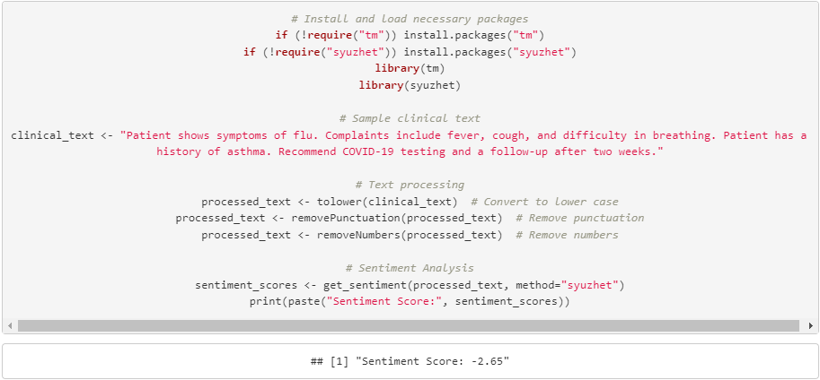
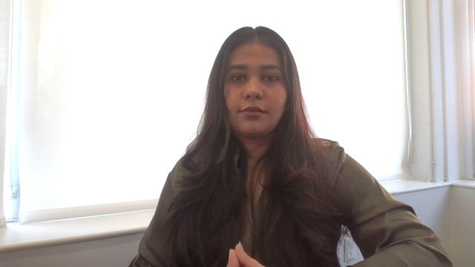
Proof of Concept
Our proof of concept demonstrates the practical application of Clinical NLP. The process begins with text processing, converting clinical text to lowercase, removing punctuation and numbers, and then performing sentiment analysis to understand the emotional tone of the clinical text
Notes:
Our proof of concept demonstrates the practical application of Clinical NLP in processing clinical texts. This involves cleaning the text and analyzing its sentiment, offering a glimpse into the potential of this technology in real-world healthcare settings.

Slide 9
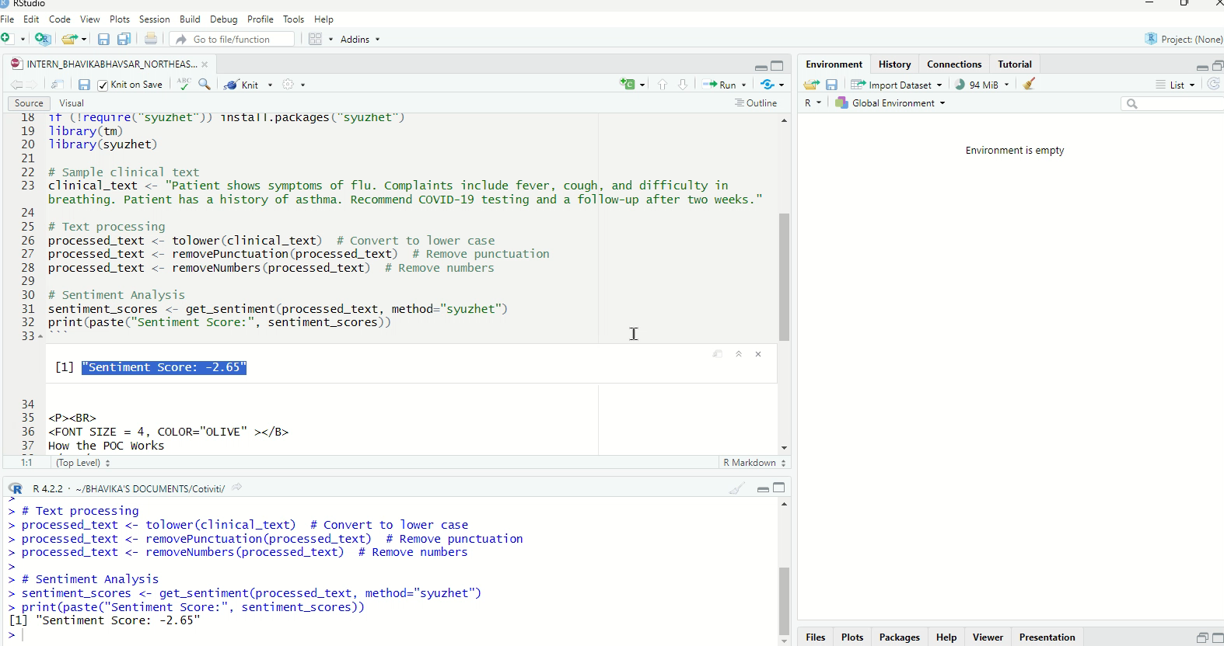
Working POC snippet

Slide 10
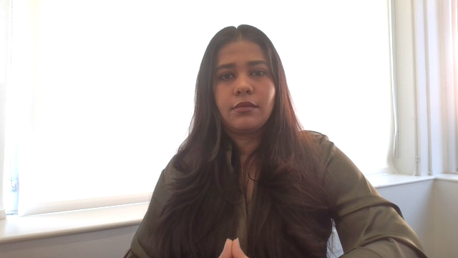
Conclusion of POC
The sentiment score obtained from the analysis offers insights into the emotional tone of clinical texts. This can be instrumental in understanding patient well-being and treatment responses, demonstrating the practicality and potential of Clinical NLP in healthcare settings.
Notes:
The sentiment analysis in our POC highlights how we can gauge patient wellbeing and treatment responses from clinical notes. This basic demonstration underscores the capability of Clinical NLP to provide deeper insights in healthcare.

Slide 11

References
Data Science Connect. (2021). Natural language processing in healthcare: Trends and use cases. Data Science Connect.
Esteva, A., Robicquet, A., Ramsundar, B., Kuleshov, V., DePristo, M., Chou, K., ... & Dean, J. (2021). Deep learning-enabled medical computer vision. npj Digital Medicine, 4(1), 1-9.

Slide 12


Thank you!

